Slide 1

Matrix building with Mobile Network Data
Dominic Duke, July 2021

Slide 2
Introduction
Overview
Mobile Network Data, or Mobile Phone Origin Destination Data? Interchangeable to some extent, although MPOD is a more accurate definition of what the data contains.
Specification
Verification
Adjustment
Processing Methods
Matrices should be considered alongside the network and not as a separate exercise.

Slide 3
Introduction
Decision making
Many decision points in the process.
Consider:
Programme implications;
Cost;
Accuracy of output;
Downstream effects (e.g. forecasting).
Very easy to lose sight of these!
Be aware of likelihood of things not going to plan & talk to PMs about it.

Slide 4
Introduction
Project List & Contacts
Suffolk County Model – Michael Johns;
King’s Lynn Transport Study – Michael Johns?;
Norwich Western Link – Craig Drennan;
Wisley Airfield – Nicola Tedoldi;
A259 Bognor Regis to Littlehampton – Alex Georgeson / Dan Hyde;
WECA Model (WERTM) – Chris Sanders.

Slide 5
Introduction
Guidance - WebTAG Unit M2.2
https://assets.publishing.service.gov.uk/government/uploads/system/uploads/attachment_data/file/938859/tag-m2-2-base-year-matrix.pdf
How DfT expect us to build matrices
Appendix B.5 – Considerations for Specific Data Sources, MND

Slide 6
Specification
01
Mobile Network Data

Slide 7
Specification
Introduction
Network Providers
Inherency
Model Structure
Specification Structure:
Spatial Coverage & Movements;
Spatial Resolution;
Temporal Coverage;
Mode of Travel;
Purpose of Travel;
Deliverables.

Slide 8
Specification
Choice of Provider
Be aware of what network each provider uses:
BT (EE);
Teralytics (Three);
Telefonica (O2);
Citi Logik (Vodaphone).
Differences in:
Sample sizes;
Cost;
Transparency;
Anonymity filtering;
Duration queries can be raised.
Notes:
My experience is mostly with Telefonica, although others have used Citi Logik. BT have previously been used by Atkins and have not been available to other consultants as far as I understand, while Teralytics is a new provider that we have done some work for more recently and looks promising both in terms of the data accuracy and their transparency when it comes to processes.

Slide 9
Specification
Inherent vs Inferred
Be aware of the difference between what is part of the data vs what has to be determined via an algorithm.
Spatial properties: Typically Inherent, except for resolution at a finer granularity.
Mode and Purpose: Entirely Inferred.
Time: Inherent with an element of inferred.

Slide 10
Specification
Model Structure
Consider how people are going to get between areas; Do you have skeletal buffer network or just external links? How does this affect model structure?
Car parks in central areas?
Segmentation requirements (Time, Mode, Purpose).

Slide 11
Specification
Spatial Coverage & Movements
Spatial coverage influences the cost & filtering required later.
Four main movements to consider:
Internal – Internal
Internal – External
External – Internal
External – External
We always want all four, but for Ext-Ext only for trips through study area.
Ext-Ext trips are the problem when we look at having a greater spatial coverage.

Slide 12
Specification
Spatial Resolution
Granularity influences:
Cost;
Accuracy.
Higher granularity doesn’t necessarily mean better.
Operators have to infer locations once below a certain level (mast coverage).
Experience shows District is a very good match, while MSOA starts becoming less accurate, and LSOA is not a good match when comparing against populations.

Slide 13
Specification
Temporal Coverage
Influences:
Cost; and
Accuracy.
Anonymity processes can alter accuracy if periods are too short.
Verification of the data can be more difficult if we don’t have enough time period data.
Pick neutral month(s) for data collection. Ideally a similar time to any manual data collection. March, September, October are typically good months (excluding bank hols / school hols).

Slide 14
Specification
Modes of Travel
Mode of travel has to be inferred.
Probably the least accurate part of anything a provider can give.
Be cautious about exactly how broken down you need, and be aware of the trade off between accuracy, later processing, and data availability.
AECOM stance on WECA:
Aggregate everything back together;
Create synthetic matrices for everything other than Car;
Take off synth matrices from MND and be left with car matrix.
Is this accurate? Depends on data availability and how good you think the synth matrices are going to be.

Slide 15
Specification
Purposes of Travel
As with mode, this is entirely inferred from the data.
Typically:
Commuting (Home-Based Work);
Home-Based Other;
Non-Home-Based Other.
Other purposes that may be of interest:
Employer’s Business (hard for operators to filter out)

Slide 16
Specification
Deliverables
Data
Note differences in how different providers produce the data:
Average day or total trips;
How anonymity processes are applied;
Check data on receipt and make sure it has everything requested;
Check timescale for any queries to go back to operator.
Reporting
Try and get as much out of the operator as possible. How have they processed data? Can they run some of the verification tests themselves?

Slide 17
Specification
Other Important Considerations
Delivery date / processing time
Query period
Limitations on use of data – is it project specific, client specific, etc?

Slide 18
Verification
02
Mobile Network Data

Slide 19
Verification
Introduction
What guidance is there?
Comparison against baseline datasets.
Understand biases and errors.
Primary areas of testing.
Ongoing testing.
Previous experience.

Slide 20
Verification
Guidance - WebTAG Unit M2.2
https://assets.publishing.service.gov.uk/government/uploads/system/uploads/attachment_data/file/938859/tag-m2-2-base-year-matrix.pdf
Section 6 (Matrix Verification and Refinement)
Table 2

Slide 21
Verification
Baseline Datasets
National Datasets
NTEM: Freely available through TEMPro;
Census: Freely available online;
NTS: Aggregated available online, record-based available through UK Data Service although only with license agreement. Processed data in MTG folder.
Local datasets (where available)
Flow data (e.g. screenlines, total proportion of modes over sample of count sites, ANPR);
TrafficMaster / Teletrac OD data;
Ticket data;
Interview data (PT Intercept, RSI, Household interviews).

Slide 22
Verification
Errors and Biases
Be aware of limitations of every dataset
Refer to M2.2 if necessary
Understand ‘skew’ that each error or bias introduces
Don’t need to correct for it, but just be aware in reporting
There is no perfect dataset in what we have available

Slide 23
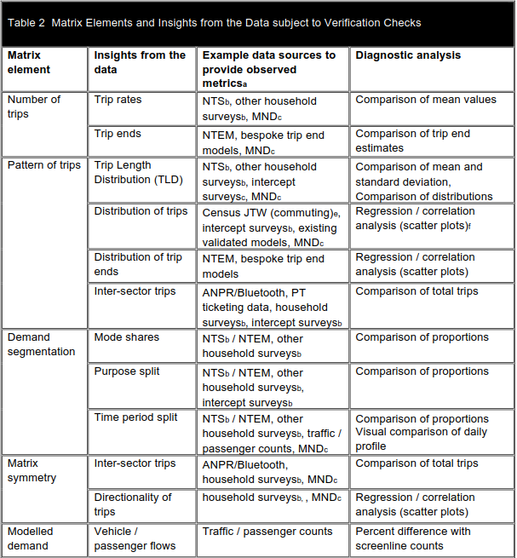
Verification
Primary areas of testing
Table 2 of M2.2

Slide 24
Verification
Ongoing testing
Continue to test during matrix development
When implementing a change, compare back against the original dataset again and see how the new data performs.
MTG - Matrix Inspection Tool

Slide 25
Verification
Previous Experience
Not hard and fast rules, but just what I’ve found in general.
Telefonica datasets:
Lack short trips;
Lack HGV trips;
Require some matrix-wide scaling towards the end (normally increases) even after fixing the above.

Slide 26
Adjustment
03
Mobile Network Data

Slide 27
Adjustment
Introduction
Understanding the data we have been given.
What do we need to do?
Segmentation (Time, Mode, Purpose);
Conversion (Person Trips);
Fix problems (short distance trips, anything else Verification has told us);

Slide 28
Adjustment
Understanding the Data
What has already been done before we receive the data?
Raw data: Pings from phones to masts.
Inherency vs Inference.
What rules have been applied?
Trip stop determination (time staying still) – typically 30 minutes;
Purpose allocation – home and work identification;
Mode allocation – algorithms;
Spatial determination for Ext-Ext trips.

Slide 29
Adjustment
Segmentation - Time
Not a lot we can do about time segmentation other than talk to operator.
Be aware of how time has been determined and how that might skew things.
Make sure time period definitions and therefore factors are correct. e.g. is your model representing the peak hour or average hour?

Slide 30
Adjustment
Segmentation - Mode
How have modes been filtered by the operator?
What additional modes do we need to filter? E.g. ‘Motorised Road’ to Car, Bus, LGV.
What modes will have the most effect on the model / scheme?
Can we construct a synthetic version that might be more accurate? This depends on what data we have.
If you get stuck, consider working backwards from something else:
e.g. when splitting Car+LGV into Car / LGV, can you control to something car-based instead of trying to find LGV specific datasets? NTEM contains Car estimates but no LGV estimates.

Slide 31
Adjustment
Segmentation - Purpose
What purposes are required?
What are the characteristics of the origin and destination, and therefore why might there be errors and how might these manifest? E.g. education destination vs workplace destination.

Slide 32
Adjustment
Conversion – Person Trips
WebTAG Databook Vehicle Occupancy values
Consider Car / LGV elements and what order these adjustments should be done in.
PCU values based on model parameters.
Typically public transport segments don’t need adjustment.

Slide 33
Adjustment
Rail Redistribution
Rail trips are origin – destination, not station – station.
Consider access and egress trips from stations
Gravity model or similar to determine movements to stations.

Slide 34
Adjustment
Fixing Problems – Short Trips
Generate a synthetic matrix and ‘fuse’ this to the observed matrix to infill short distance trips.
What should we use to generate a synthetic matrix?
CTripEnd (NTEM database);
NTS for trip lengths;
Local information.
Typical fusion process:
Determine appropriate distance for join (8km / 5 miles is typical);
‘Hard’ boundary between the two parts of the matrix, based on crow-flies distance between trip pairs.

Slide 35
Adjustment
Fixing Problems – Verification
Determine from verification what the likely problems are
Judgement – not obvious
May required further testing
Review tools such as Matrix Estimation

Slide 36
Adjustment
Processing Methods
Lots of steps to the process
Lots of scope for adjustment to any individual process
Programming suited to this e.g. Python
Could use programming interface such as CUBE or similar
Preferably stay away from Excel:
Becomes unwieldy quickly with large datasets;
Very error prone & hard to check.

Slide 37
Questions & Discussion
?

